Slide 1



Spiritual Tablet

Slide 2
Welcome to our team
one and all …..

Slide 3
INTRODUCTION
Let me introduce you our team members
And enlighten u with their areas of work….

Slide 4
Dr.Gopala Krishna (G.K.)
C.E.O., SPIRITUAL TABLETS

Slide 5
K.Sridevi
C.E.O.II, SPIRITUAL
TABLETS
M.S.Asha
C.E.O.III, SPIRITUAL
TABLETS

Slide 6

Specific Wing Incharges-India
Online academics –Vedavathi
Cultural-Lakshmi K
All Literatures-Praveena
New Centers- Sudha
Maintenance- kameshwara Rao
Materials- Geetha

Slide 7
W.LAKSHMI
(VIZAG)
WEBSITE INCHARGE
Static content upload
Events & Photos Upload
Operators coordination
Dynamic Backend
GEETHA
(VIZAG)
MATERIAL INCHARGE
Pocket books printing & supply
SP Tab audio’s supply
SP Tab audio visual’s Supply
Short films Supply
All Kinds of Pyramids

Slide 8
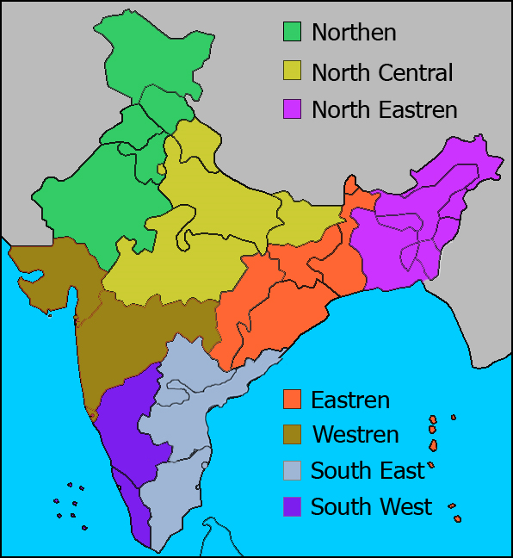

Slide 9
Zone No | Zonal Director | Area | States
1 | Praveena | Northern | Chandigarh, Haryana, Himachal Pradesh, Jammu and Kashmir, Punjab, Rajasthan
2 | Kakinada Sudha | North Central | Madhya Pradesh
2 | Ramaraju | North Central | Bihar, Delhi
2 | Vineeth | North Central | Uttar Pradesh, Uttrakhand
3 | Renu | North Eastern | Arunachal Pradesh, Assam, Manipur
3 | Sunitha | North Eastern | Meghalaya, Mizoram,Nagaland,Tripura
4 | Sushma | Eastern | Andaman and Nicobar Islands, Chattisgarh, Jharkhand
4 | Rinku | Eastern | Odisha,Sikkim,West Bengal
Contd.,

Slide 10
Zone No | Zonal Director | Area | States
5 | Himangi Belsare | Western | Dadra and Nagar Haveli, Maharashtra
5 | Suvarna | Western | Daman and Diu, Goa, Gujarat
6 | Kamesarawara Rao | South East | Tamil Nadu, Puducherry
6 | Laxmi Prasanna | South East | Andhra Pradesh, Telangana
7 | Vedavathi | South West | Karnataka, Lakshadweep
7 | Seema | South West | Kerala
8 | Dr.Gopala Krishna | Aboard | -

Slide 11
Concern to …
Dr.Gopala Krishna
Workshops, Level II & III
SP Tab upgrade
Cultural backend
Zonal Incharge Aboard
Sridevi
Workshops ,Level I & II
Monitoring Counsellor's
All other Academics

Slide 12
Concern to …
Asha
Monitoring administrative users
Finance
Core coordination, departments
Vedavathi
Online Workshops
Online Counseling's
South West Zonal Director
SP tab upgrade

Slide 13
Concern to …
Lakshmi Prasanna
workshops level I& II
SP tab upgrade
South East Zonal Director
Sudha-New centers establishment & initial maintenance
Kameshwara Rao – Existing Centers Maintenance

Slide 14
Concern to …
W.Lakshmi – Web Construction and operation
K.Lakshmi – Cultural Events &Publicity
Saragalu Lakshmi
Music & Dance Learning Center maintenance
Workshop Level I

Slide 15
Corcern to …
Geetha – Material Incharge
Praveena
North India Incharge
Newsletter
Material Translations
Lakshmi Prassana
Workshops level I & II
SP tab upgrade
South East Zonal Director

Slide 16
THANKING YOU

